Slide 1
Monday
WALT: Capture vocabulary for a poem

Slide 2
peaceful
Adjective
not easily moved to argue or fight
a peaceful people.
2 : full of or enjoying quiet, calm, or
freedom from disturbance.
3 : not involving fighting.
Similar - calm, tranquil, serene,
placid, peaceful
Similar:

Slide 3
To recap features of a poem

Slide 4
Types of poems…so far…
Similes Poem
Alliteration Poem
or Tongue Twister
Nonsense Poem
Acrostic Poem
Prose Poem
Narrative Poem
Riddle Poem
Shape Poem
Rhyming Poem

Slide 5
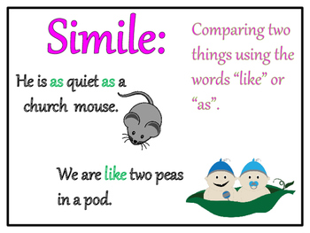

Slide 6
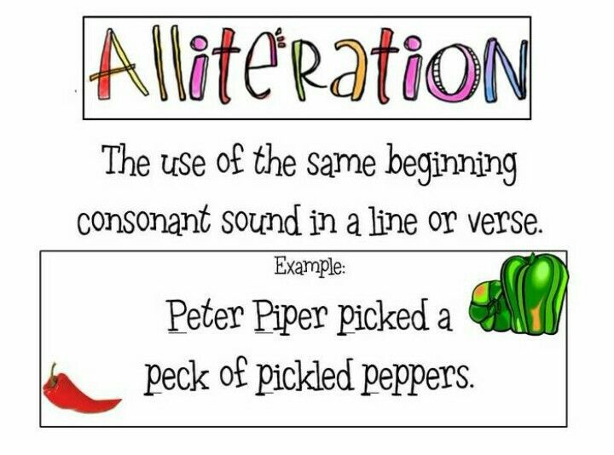

Slide 7
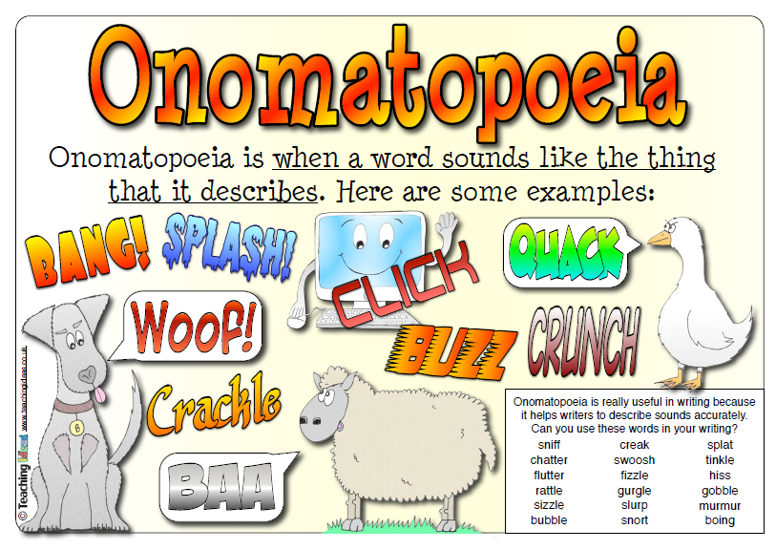

Slide 8
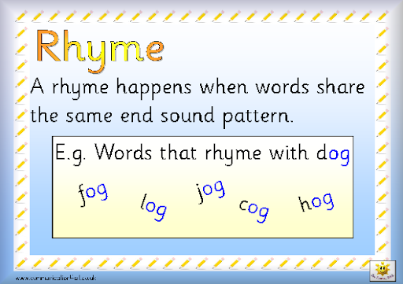

Slide 9
https://www.youtube.com/watch?v=9pySbAcz1TQ

Slide 10
Key skills
To discuss the poems

Slide 11
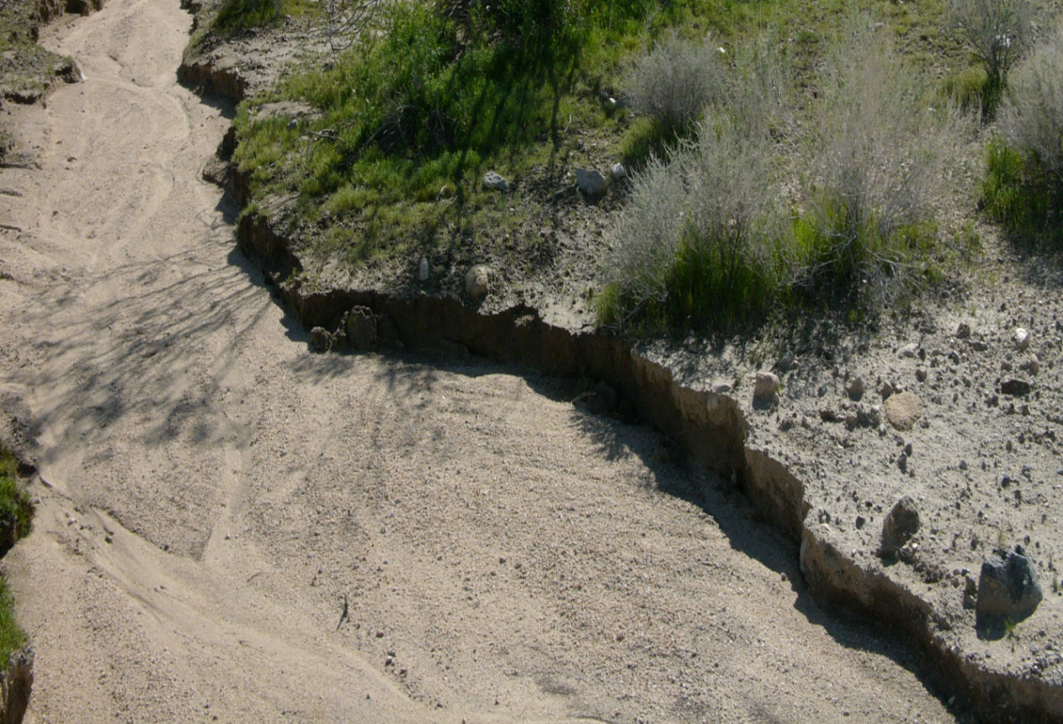
Dry River Bed by Esnala Banda
The river- was, but died away,
leaving behind sand and stone,
a dry river bed.
The river that once led the way,
To Rameses throne,
Has no more life- dead.
The river from which reeds grew and swayed,
now dead and gone,
all that's left-a dry river bed.
The river that was marvellous by day,
and treacherous once the sun was gone,
is now but a dry river bed.
The river- beautiful, no words could say,
left behind - just a dry river bed.

Slide 12
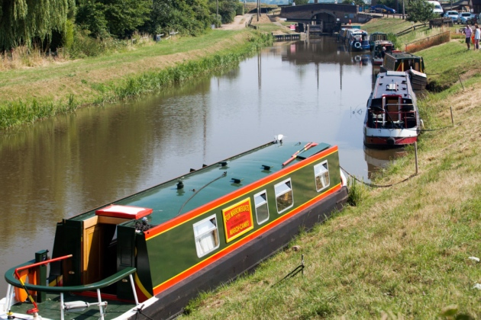
WHERE GO THE BOATS?
Dark brown is the river,
Golden is the sand.
It flows along for ever,
With trees on either hand.
Green leaves a-floating,
Castles of the foam,
Boats of mine a-boating -
Where will all come home?
On goes the river
And out past the mill,
Away down the valley,
Away down the hill.
Away down the river,
A hundred miles or more,
Other little children
Shall bring my boats ashore.
By
Robert Louis Stevenson

Slide 13
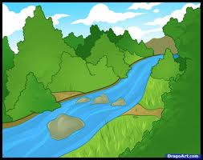
Stream Story
Stream in the hillside,
Burbling, trickling,
Splashing through my fingers,
Tugging and tickling.
Tumbling to the valley,
Gurgling, growing,
Pooh-stick highway,
Filling and flowing.
Bustling with water life,
Flourishing, thriving
On water, underwater,
Swimming and diving.
Now a mighty waterway,
Ships in motion,
Taking all the traffic
To the great, grey ocean.
By Paul Bright

Slide 14
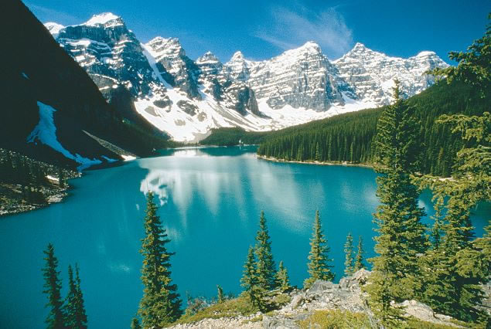
The Lake
On a calm day
The lake
Imagines it is a mirror
And smiles back
At people who pass by
Smiling.
On a breezy day
The lake
Hunches its shoulders
And sends ripples
Scudding across the surface.
On a winter’s day
The lake
Hides itself
Under a frozen blanket
And refuses to budge
Until it is warm enough
To come out again.
John Foster

Slide 15
The Sea
Pools prink plip
Ripples ring rocks
Surf sings softly
Fat foam flecks
White waves whip
Breakers beat boulders
Wind wildly whistles
Waves whack wallop
Wind wildly whistles
Breakers beat boulders
White waves whip
Fat foam flecks
Surf sings softly
Ripples ring rocks
Pools prink plip
Kevin Mc Cann

Slide 16
WALT> recognise descriptive language in a poem.
amazing, beautiful adjectives | Rhyming Words to make our river, all of a shiver | Repetition, Repetition
Similes like… …as… | Onomatopoeia- wow! | Amazing Alliteration
What made you go WOW?

Slide 17
WALT> recognise descriptive language in a poem.
amazing, beautiful adjectives dry, river bed | Rhyming Words to make our river, all of a shiver sand-hand boating- floating motion - ocean | Repetition, Repetition dry river bed.
Similes like… …as… | Onomatopoeia- wow! burbling trickling | Amazing Alliteration ripples ring rocks surf sings softly fat foam flecks white waves whip gurgling growing
What made you go WOW? treacherous marvellous

Slide 18
Alternative adjectives
small |  |  |  | big
tiny | minute | miniature | pocket-sized | enormous |  | gigantic |  | mammoth | thundering
microscopic | meagre | modest | insufficient | monumental |  | whopping |  | colossal | giant
slight | diminutive | petite | ­­­­teensy | large |  | huge |  | sizeable | vast
quiet |  |  |  | loud
silent | peaceful | muted | soft | deafening |  | intense |  | raucous | resounding
hushed | muffled | mute | reserved | roaring |  | thundering |  | booming | crashing
noiseless | speechless | soundless | inaudible | ear-piercing |  | piercing |  | deep | boisterous
slow |  |  |  | fast
gradual | moderate | reluctant | leisurely | speedy | rapid |  | brisk |  | nimble
sluggish | crawling | dawdling | idle | swift | dashing |  | flashing |  | hurried
plodding | slack | creeping | lagging | hypersonic | agile |  | quick |  | racing

Slide 19
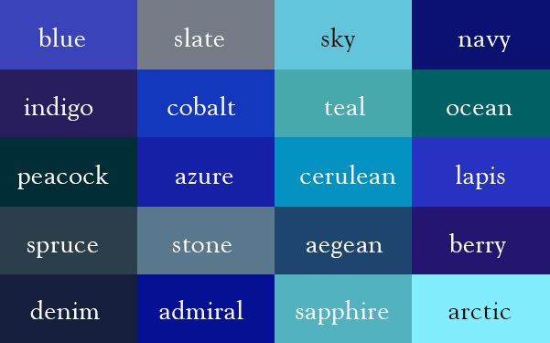
Degrees of Meaning – not just blue…

Slide 20
Securing skills
To use poems and identify examples of the different poetic features

Slide 21
Tuesday
WALT: Plan a water poem using alliteration, similes, rhyme, onomatopoeia

Slide 22
To recap poetic features

Slide 23
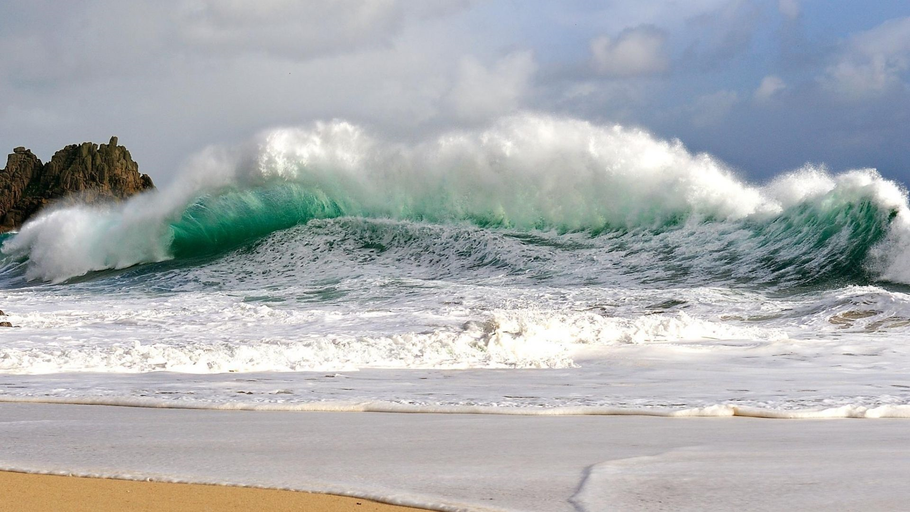

Slide 24
Key skills
To write alliterative phrases, similes and onomatopoeia words to describe the picture

Slide 25
Securing skills
To create a mind map to plan ideas for a water poem

Slide 26
Wednesday
WALT: Write a water poem

Slide 27
Let’s recap our mind maps from yesterday

Slide 28
Securing skills
To write a water poem including the poetic features

Slide 29
Marking Ladder
I have included | Me | Teacher
capital letters, full stops and commas.
adjectives
rhyme
repetition
alliteration
onomatopoeia
adverbs
adventurous word choices
WWW |  | Next Step

Slide 30
Mastery
To use a thesaurus to develop your water poem

Slide 31
Thursday
WALT: To edit water poems

Slide 32
Editing Work
Check
Capital letters to start a new line (for a poem)
Commas and full stops
Exclamation marks and question marks
Joined handwriting sitting on the lines.
Spellings
best word choices
includes
adjectives
similes
alliteration
onomatopoeia

Slide 33
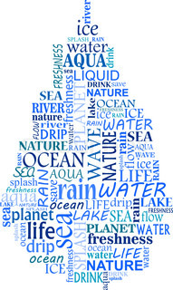
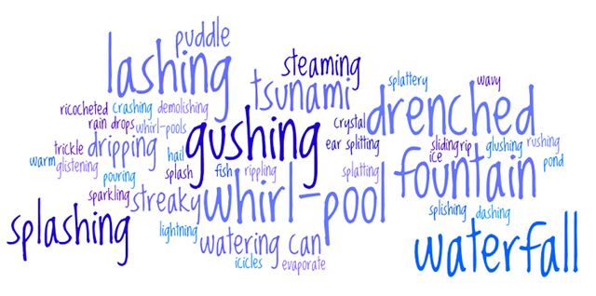
Watery Words

Slide 34
Key skills
To read and edit grammatical errors in water poems

Slide 35
Securing skills
To edit water poems using a thesaurus

Slide 36
Friday
WALT: SPAG assessment

Slide 37
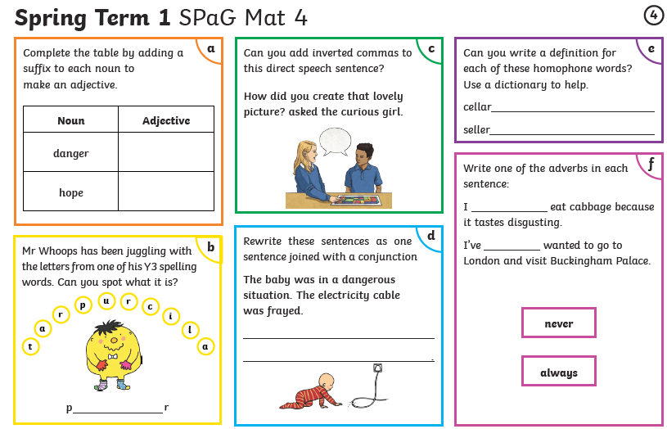

Slide 38
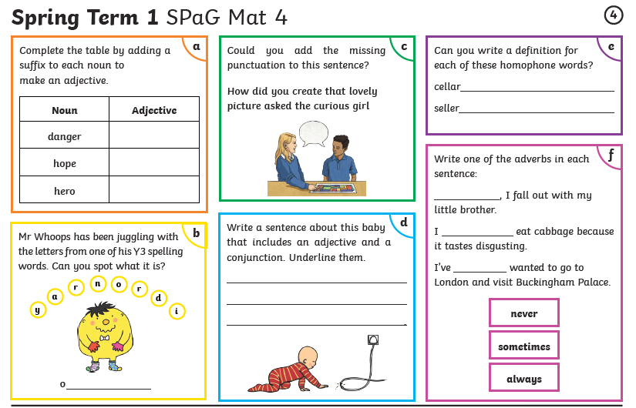

Slide 39
