Slide 1
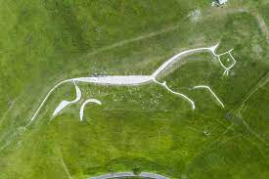
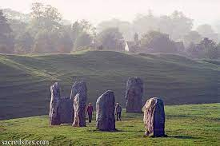
FS Parents
Information Evening
September 2023
Miss Braden- SEN Support
Mrs Keeping & Mrs Halliday- Uffington
Miss O’Sullivan & Miss Jones - Avebury

Slide 2









Our Topics:
How do people live around the world?

Slide 3

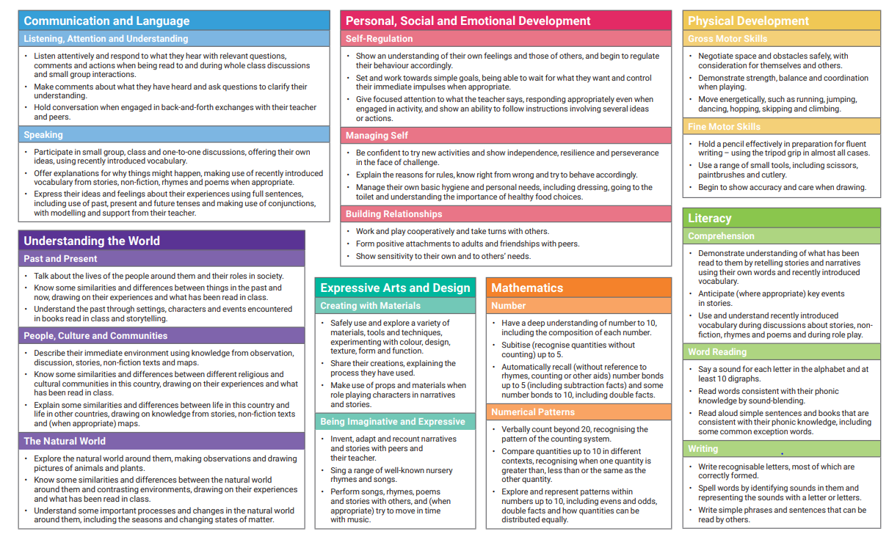

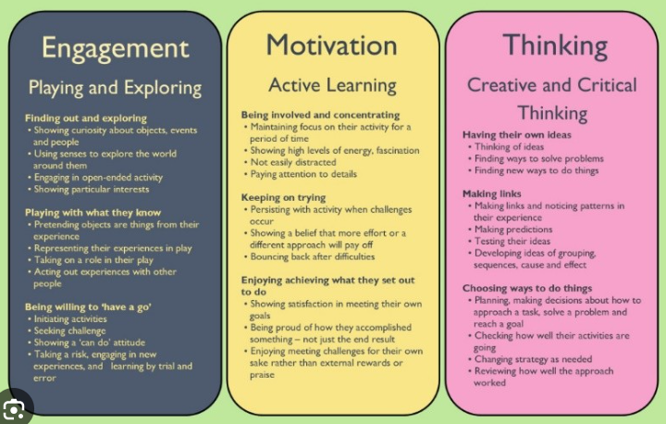
Our Curriculum

Slide 4
Phonics
In FS we will learn Phase 2 and 3 sounds and how to apply them when reading and writing. By the end of the year, we would like them to be able to read sentences independently using their phonics knowledge with fluency, talk about and answer questions about the text. They should also be able to read some high frequency words (‘tricky words’)
When your child comes home with a reading book it is important to focus on segmenting (sounding out) a word and then blending the sounds together afterwards.
At the end of each week we will send home phonics homework based on the phonemes they have been taught that week. Please practise saying and writing these sounds with your child. This will have pictures that will remind the children of the phoneme (sound) that matches each grapheme (written letter).
If you are unsure of how to pronounce the sounds please either ask a teacher, follow this link https://www.youtube.com/watch?v=IwJx1NSineE or search on YouTube for ‘Sounds of the English Phonic Code -Synthetic Phonics’.

Slide 5

Handwriting
Print handwriting EYFS & Year 1
Joined handwriting from Year 2

Slide 6
Reading – 10 mins, 5 days a week.
Homework – Challenge of the Week
Maths or literacy based activity (folder to be sent home on a Friday and homework to be brought back by Tuesday)
Phonics (sound mat) – We will be sending home a phonics homework folder.
HOMEWORK
At the end of each week we will send home phonics
homework based on the phonemes they have been taught that week. Please practise saying and writing these
sounds with your child. This will have pictures that will remind the children
of the phoneme (sound) that matches each grapheme (written letter).

Slide 7

PE kits and days
PE is on Tuesday.
Please make sure all items of clothing are labelled including those the child is wearing. This will avoid any confusion when the children are changing for PE.
Please help your child to practise getting changed independently including, doing buttons, zips and putting tights/socks on and off.
Notes:
Expectation is that they will get changed independently and only occasionally need help. Otherwise this can eat into valuable lesson time.

Slide 8


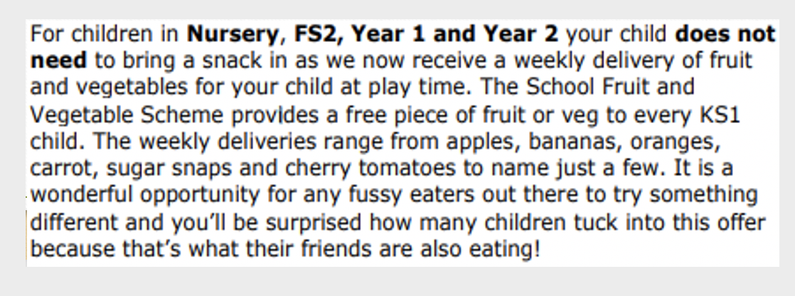
Water bottles and fruit snack
Snack –
Please note this is different to Years 3, 4, 5 and 6.
Please make sure your child has a water bottle that they can open and close themselves. No squash please!

Slide 9


Rewards and Consequences
REWARDS
Verbal praise
Stickers
Certificates
Dojos
Visit to a member of SLT (Senior Leadership Team)
Visit the Headteacher
Work on display
CONSEQUENCES
Verbal warning
Time-out- in their own class or partner class
Discussion with parents
See a member SLT
See the Headteacher
Inclusion team to support with behaviour.

Slide 10
Drop off & Pick Up
In the morning the door will be opened at 8:30 – 8:45 and all the children will enter through one door. If you arrive after 8:45, you will need to take your child to the office.
At the end of the day, both classes will exit via the link corridor, however each class will have their own door. Please can you ensure you are stood on the correct side depending on which class your child is in.

Slide 11


Any questions….

